Slide 1
Econ 106
Lecture 13
slides derived from:
https://www.tidytextmining.com/tidytext

Slide 2
Reminders
Research Milestone #2 due Sunday, 11:59pm
Please review the feedback from MS #1, let me or Fan know if you have any questions
https://pollev.com/vsovero

Slide 3
Outline
Text as Data:
tokenization
stop words
stemming
n-grams

Slide 4
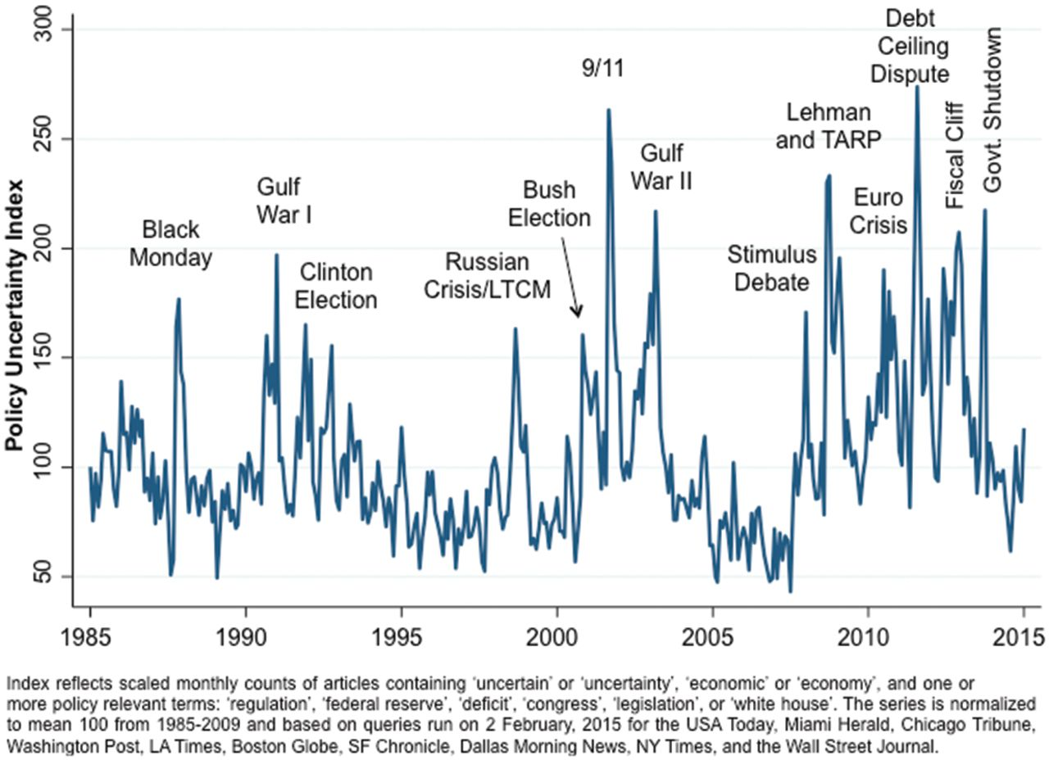

Text as Data: Tracking Policy Uncertainty
Authors track number of mentions of economic policy uncertainty in newpapers
Policy uncertainty is associated with:
Greater stock price volatility
Reduced investment and employment
Notes:
Figure I EPU Index for the United States
Unless provided in the caption above, the following copyright applies to the content of this slide: © The Author(s) 2016. Published by Oxford University Press, on behalf of President and Fellows of Harvard College. All rights reserved. For Permissions, please email: journals.permissions@oup.com

Slide 5
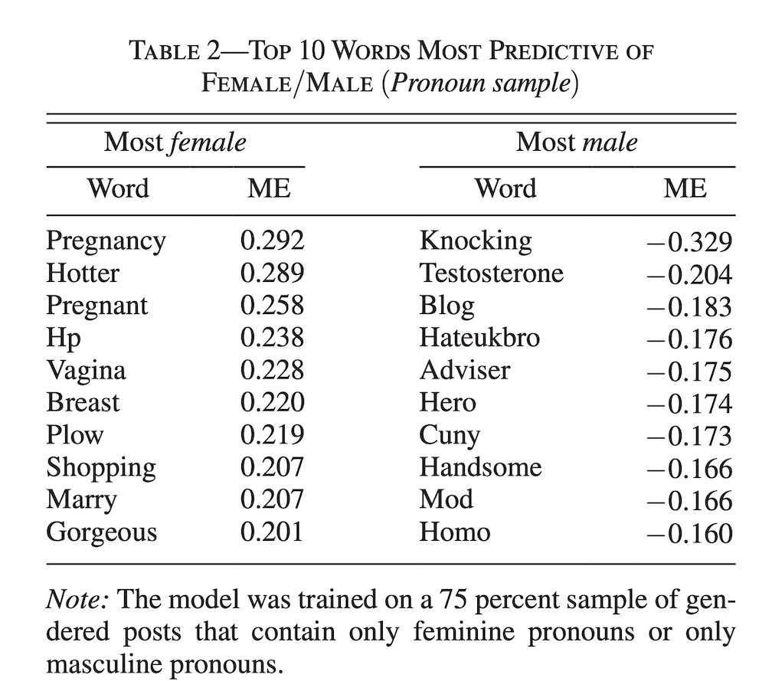
Text as Data: Gender in Economics
Econjobrumors is a popular online forum for economics graduate students
Author tracks words used in posts that refer to males vs. females
Wu, Alice H. 2018. "Gendered Language on the Economics Job Market Rumors Forum." AEA Papers and Proceedings, 108: 175-79.

Slide 6
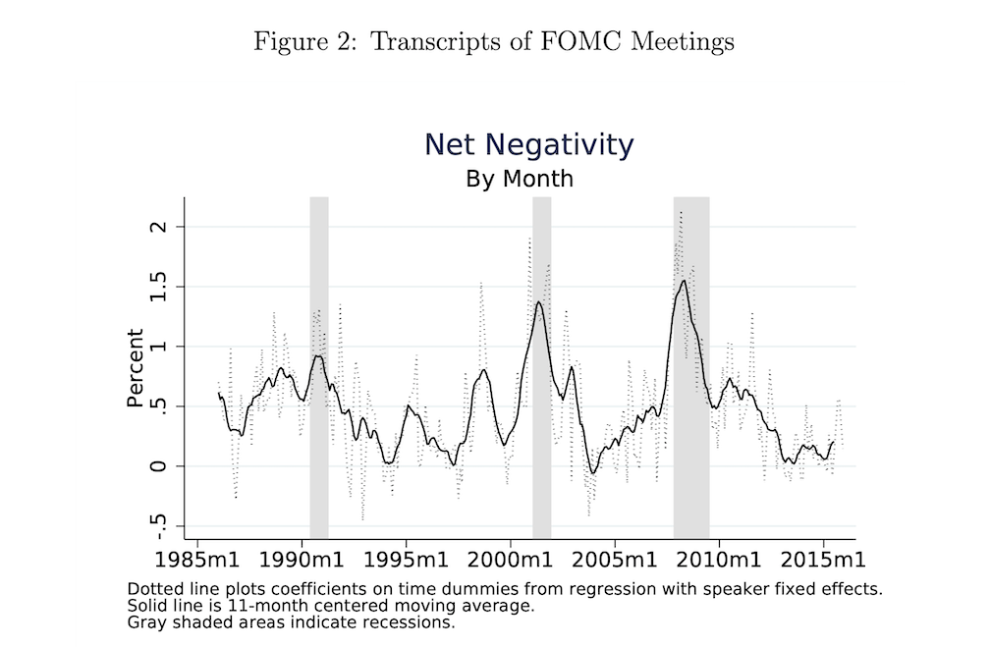
Text as Data: Tracking the Central Bank’s Preferences
Authors conduct a sentiment analysis on the transcripts of the FOMC meetings
Used to estimate the FOMC preferences regarding output and stock market performance
Adam Hale Shapiro, Daniel J Wilson, Taking the Fed at its Word: A New Approach to Estimating Central Bank Objectives using Text Analysis, The Review of Economic Studies, Volume 89, Issue 5, October 2022, 2768–2805.

Slide 7
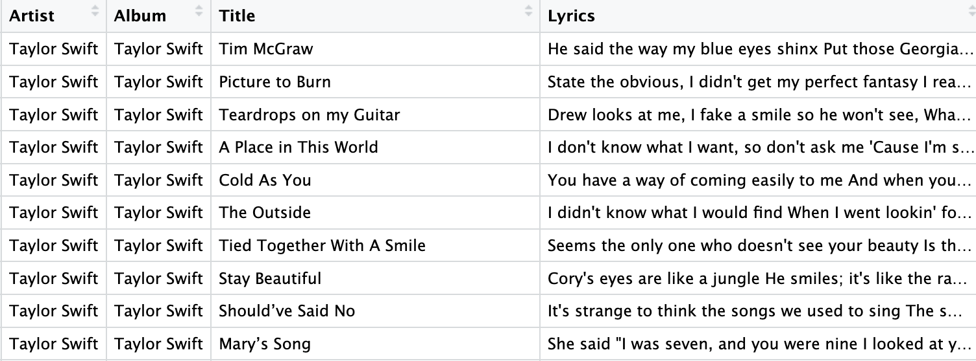
How do we analyze text?
Text is often stored as strings (many words in a single row)
For example, the entire lyrics for a Taylor Swift song is in each row:

Slide 8
String search with strngr package
Does a Taylor Swift lyric contain the word “love”?
Let’s use str_detect():
Arguments:
name of variable with the string
pattern you want to detect
Output:
TRUE/FALSE logical vector
Use mutate() to save it as a new variable
taylor_swift_lyrics_love <- taylor_swift_lyrics %>%
mutate(contains_love=str_detect(Lyrics, "love"))

Slide 9
String search
taylor_swift_lyrics_love_count <- taylor_swift_lyrics %>%
mutate(love_count=str_count(Lyrics, "love"))
How many instances of “love” are in each Taylor Swift lyric?
Let’s use str_count():
Arguments:
name of variable with the string
pattern you want to detect
Output:
numeric vector
Use mutate() to save it as a new variable

Slide 10
Class Exercise
Find out the number of times Taylor Swift lyrics include the string ”shake it off”
Find out how many songs contain the string “shake”
https://pollev.com/vsovero

Slide 11
Word Boundaries
We want to find the standalone word “love”
Not “glove”
we can use the symbol for word boundary \\b (where a word must start or end)
taylor_swift_lyrics_love <- taylor_swift_lyrics %>%
mutate(contains_love=str_detect(Lyrics, "\\b love\\b "))

Slide 12
Multiple strings
We want to find either of these :
“love”
“loving”
“lover”
use | to specify that the pattern can contain “love” or “loving” or “lover”
taylor_swift_lyrics_love <- taylor_swift_lyrics %>%
mutate(contains_love=
str_detect(Lyrics, "\\b love\\b | \\b loving\\b | \\b lover\\b"))

Slide 13
Be Careful about Upper/Lower Case
Case matters when searching for strings:
“Love” vs. “love”
taylor_swift_lyrics_love <- taylor_swift_lyrics %>%
mutate(contains_love=
str_detect(Lyrics, "\\b Love\\b | \\b love\\b "))
https://pollev.com/vsovero

Slide 14
How else do we analyze text?
Sometimes we don’t know which words or phrases we are searching for
Instead, we might want to find out the most common words or phrases in text
A token is a meaningful unit of text, such as a word, that we are interested in using for analysis
tokenization is the process of splitting text into tokens

Slide 15
Tidy Text Data
To make our text data tidy, we need to create a new row for every token in the Lyrics column

Slide 16
Converting data to tidy text
we will use the unnest_tokens() function from the tidytext library
Arguments:
the name of the input column with the text
the name of the output column where you want to place the tokens
Output:
a tidy text data frame where each row represents a token
tidy_lyrics <- taylor_swift_lyrics %>%
unnest_tokens(output=word, input=Lyrics)

Slide 17
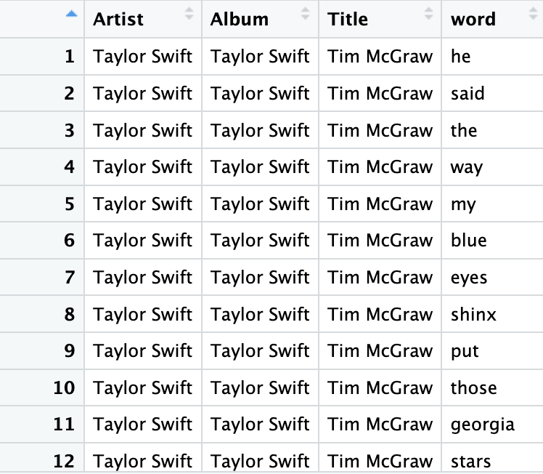
Tidy Text Data
tidy_lyrics <- taylor_swift_lyrics %>%
unnest_tokens(output=word, input=Lyrics)
https://pollev.com/vsovero

Slide 18
Frequency Table of Top Words
Ok, what are the top 20 words in Taylor Swift lyrics?
count(word) creates a frequency table for the word variable
arrange(desc( n)) sorts the frequency table from largest to smallest value of n
tidy_lyrics_count <- tidy_lyrics %>%
count(word) %>%
arrange(desc( n))

Slide 19
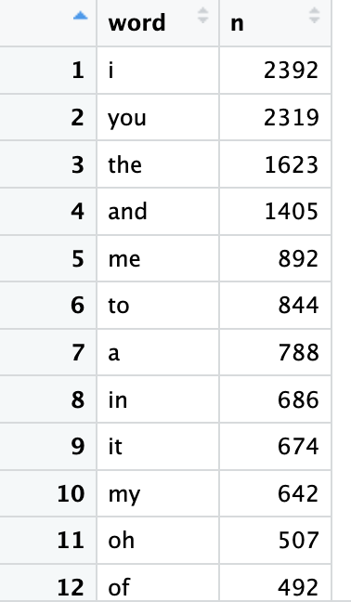
Hm, not very impressive
tidy_lyrics_count <- tidy_lyrics %>%
count(word) %>%
arrange(desc( n))
The top words don’t seem specific to Taylor Swift
They’re mainly “filler” words that everyone uses

Slide 20
Further cleanup: remove stop words
There are lots of common words that we may want to remove from our data:
the
a
is
are
Why? There carry little meaning in most text analysis
These are referred to as stop words

Slide 21
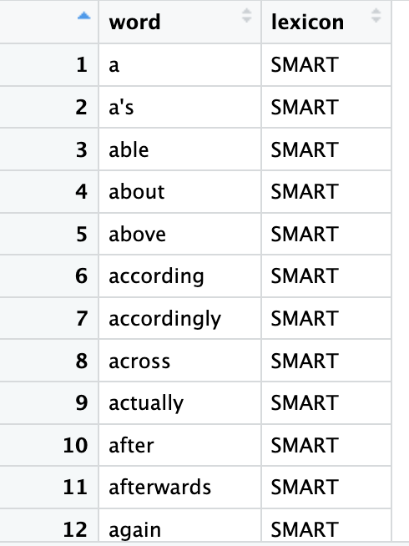
Removing Stop Words
data(stop_words)
You could try to use filter() to remove stop words, but there are way too many for this approach
the tidytext package includes a data frame of common stop words
Let’s use that to remove stop words from Taylor Swift lyrics

Slide 22
Use anti_join() to Remove Stop Words
We are going to use anti_join() to remove stop words in the tidy_lyrics
Any word in tidy_lyrics that matches to the stop words data will be removed

Slide 23
Use anti_join() to Remove Stop Words
Arguments:
x: left data frame
y: right data frame
by: linking variable
Output:
Everything in the left data frame that does not have a match to the right data frame
tidy_lyrics_remove_stop <- anti_join(x=tidy_lyrics,
y=stop_words,
by=“word” )

Slide 24
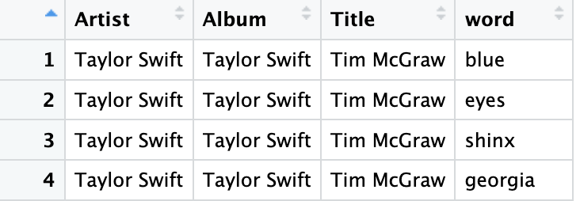
Taking out the stop words
tidy_lyrics_no_stop <- anti_join(x=tidy_lyrics, y=stop_words)

Slide 25
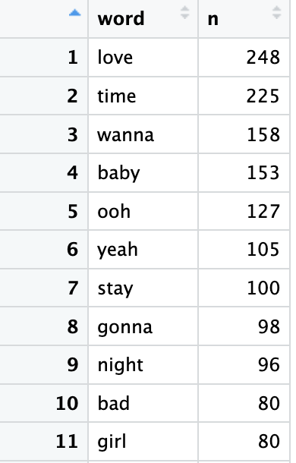
Ok, that looks better
tidy_lyrics_top_ten<- tidy_lyrics_no_stop %>%
count(word) %>%
arrange(desc( n)) %>%
slice_head(n=10)
This list looks more specific to Taylor Swift

Slide 26
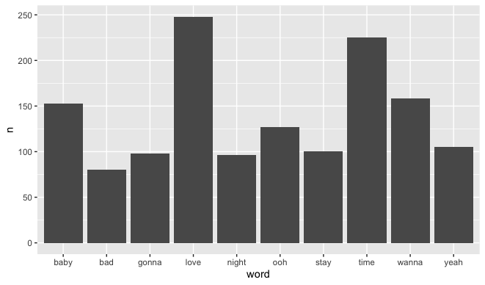
Top 10 Bar Chart (ordered alphabetically)
ggplot(data=tidy_lyrics_top_ten, mapping=aes(x=word, y=n))+
geom_col()

Slide 27
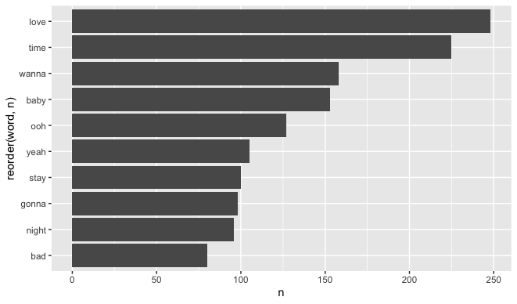
Top 10 Bar Chart (ordered by frequency and flipped)
ggplot(data=tidy_lyrics_top_ten, mapping=aes(x= reorder(word, n), y=n))+
geom_col() +
coord_flip()

Slide 28
Class Exercise
Create a frequency table of the top ten words for the folklore album
Put it into a bar chart ordered from highest to lowest frequency

Slide 29
Stemming
How do we account for the fact that there are many words that have the same base word?
For example, there are a lot of versions of “love”:
loves
lover
loving
loved
These are different versions of one base word, which is called a stem
Let’s convert the words to their stems to examine the frequency of base words

Slide 30
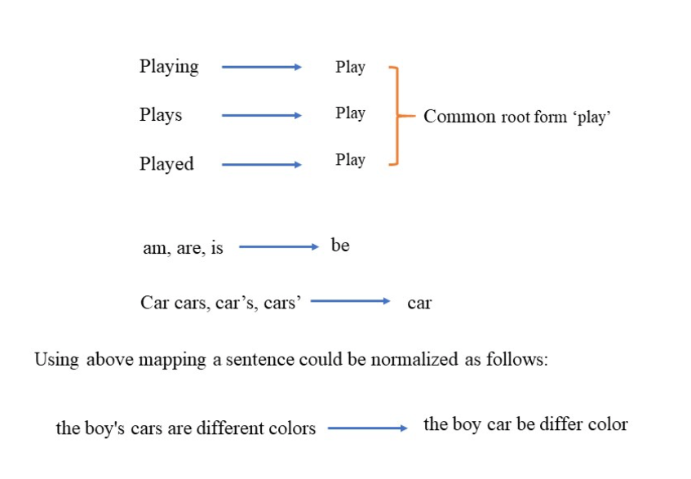
Stemming
stemming: converting words to their stem (base word)

Slide 31
Stemming
tidy_lyrics_stem<-tidy_lyrics_no_stop %>%
mutate(stem = wordStem(word, "en"))
We will use the wordStem() function from the SnowballC package
Arguments:
the name of the variable you want converted to stems
the language (English)
Output:
a new variable that contains the stems

Slide 32
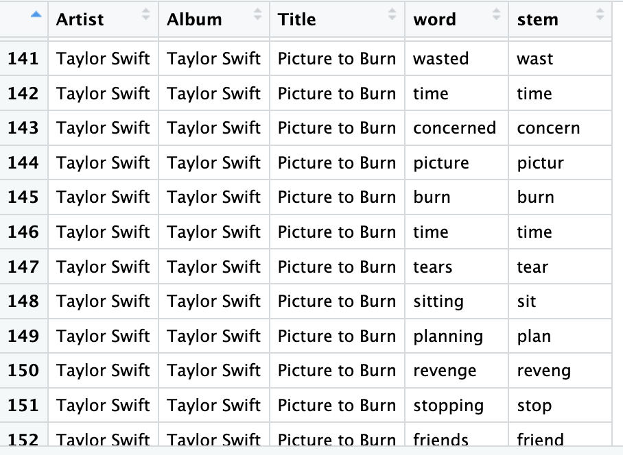
Stemming
tidy_lyrics_stem<-tidy_lyrics_no_stop %>%
mutate(stem = wordStem(word, "en"))
In this song a lot of stems are different from the original word (planning vs plan, stopping vs stop, etc.)

Slide 33
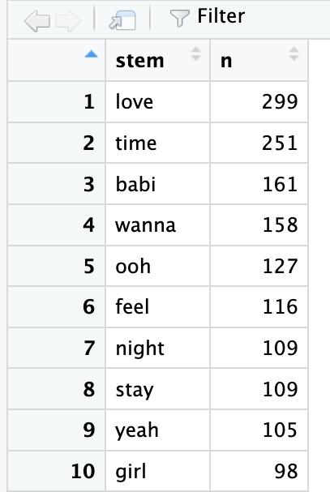
Top Stems
tidy_lyrics_stem_count <- tidy_lyrics_stem%>%
count(stem) %>%
arrange(desc( n)) %>%
slice_head(n=10)
Many stems are actual words (love, time)
Some are not (babi is the stem for baby, babies)

Slide 34
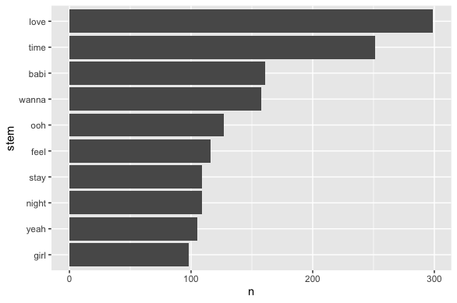
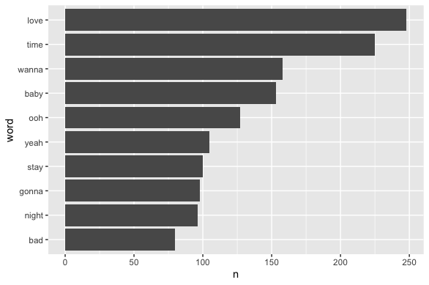
Top Stems vs. Top Words
Looks pretty similar to our top 10 word count
feel wasn’t in the word top 10, but it’s stem is used a lot (feeling, feel, feels)

Slide 35
Class Exercise
For the folklore album:
find the top ten stems (remember to remove stop words first)
Put it into a bar chart ordered from highest to lowest frequency

Slide 36
N-grams
So far, we’ve have tokenized text into single words
However, this doesn’t give us the ability to examine words in context
To do this, we can tokenize into consecutive sequences of words (n-grams):
an n-gram of 2 is two pairs of consecutive words (bigram)
an n-gram of 1 is a single word (unigram)

Slide 37
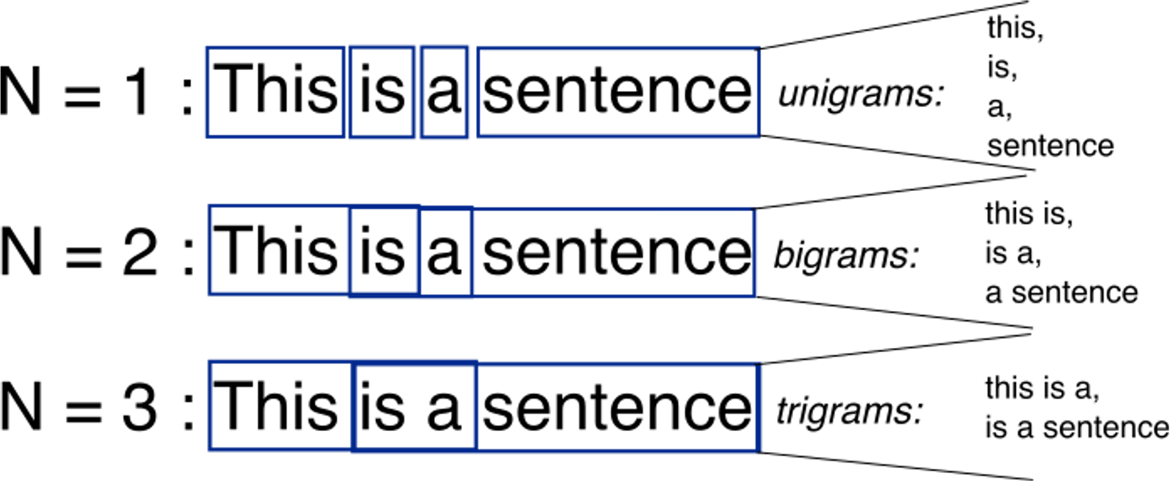
N grams
Keep in mind that n-grams greater than 1 will generate some overlap

Slide 38
N grams
Keep in mind that n-grams greater than 1 will generate some overlap

Slide 39
N grams
Keep in mind that n-grams greater than 1 will generate some overlap
https://pollev.com/vsovero

Slide 40
Tokenizing into n-grams
Additional Arguments:
token= "ngrams"
n: the number of words we wish to capture in each n-gram.
tidy_lyrics_bigram <- taylor_swift_lyrics %>%
unnest_tokens(output=word, input=Lyrics,
token="ngrams" , n=2)

Slide 41
Tokenizing into n-grams
tidy_lyrics_bigram <- taylor_swift_lyrics %>%
unnest_tokens(output=bigram, input=Lyrics, token="ngrams" , n=2)

Slide 42
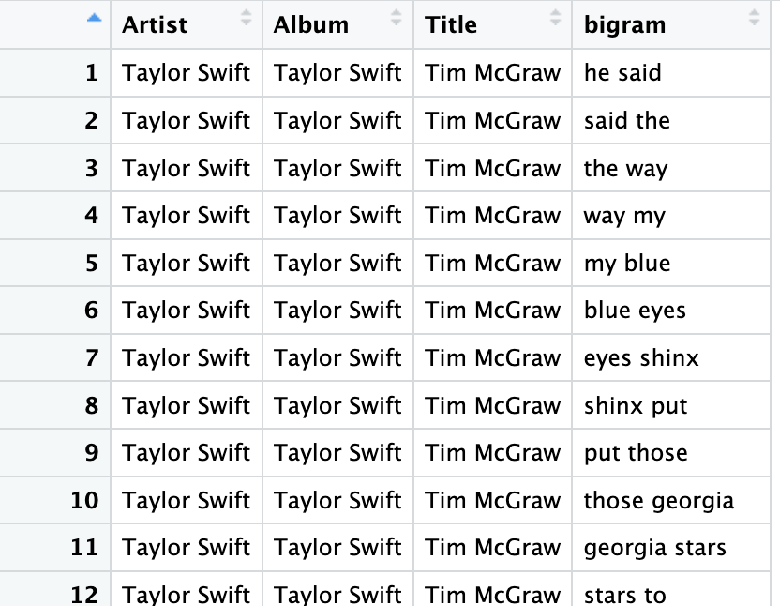
Removing Stop Words from Bigrams
It’s going to take a little more word to remove the stop words:
Split the bigram into two columns
Filter out stop_words from the two columns
Unite columns to put the bigram back together

Slide 43
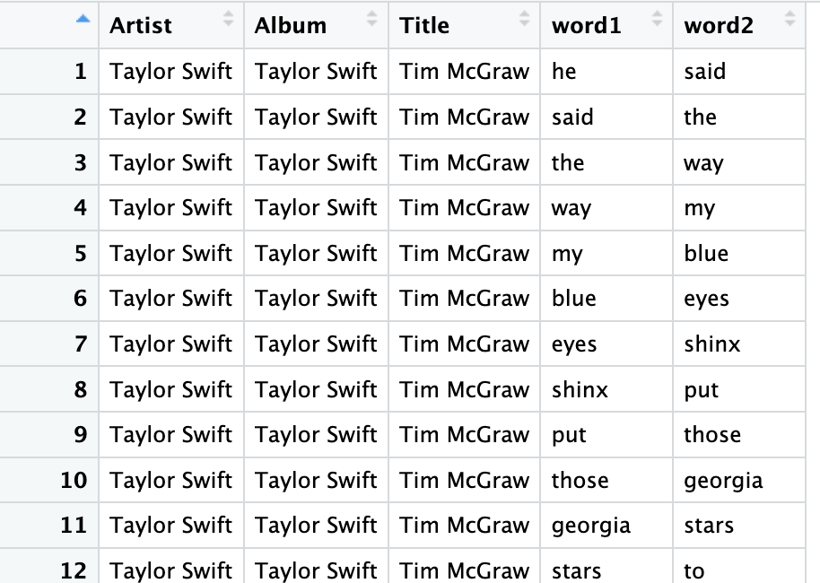
Split the bigram
tidy_lyrics_bigram_separated <- tidy_lyrics_bigram %>%
separate(bigram, into = c("word1", "word2"), sep = " ")

Slide 44
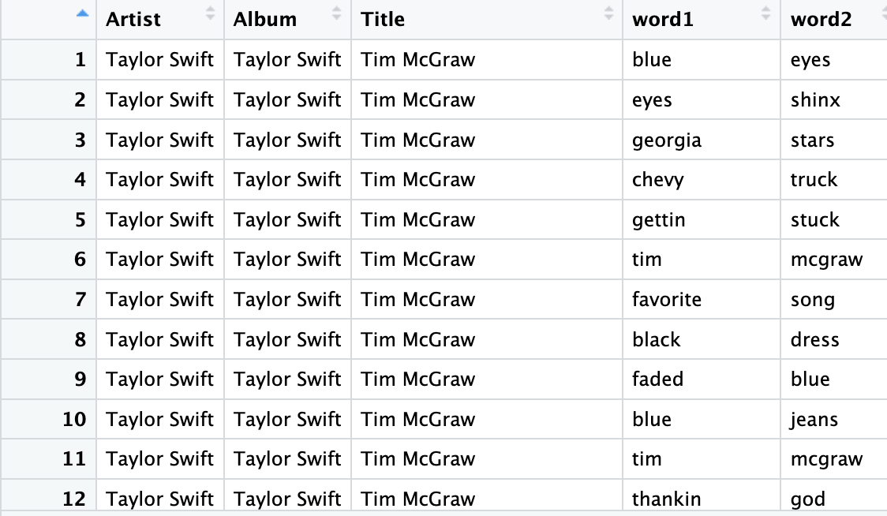
Filter Out Stop Words in Each Column
tidy_lyrics_bigram_no_stop <- tidy_lyrics_bigram_separated %>%
filter((!word1 %in% stop_words$word) %>%
filter((!word2 %in% stop_words$word)

Slide 45
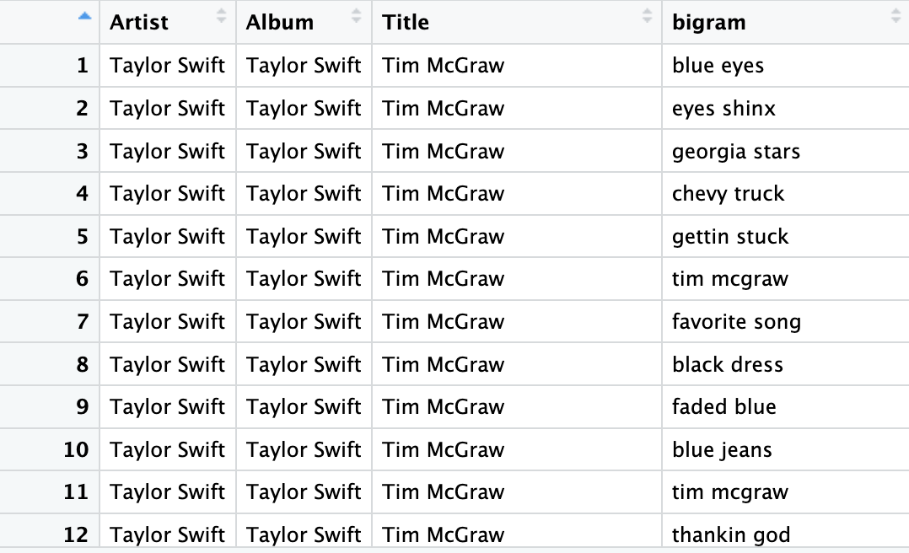
Unite the bigram
tidy_lyrics_bigram_united <- tidy_lyrics_bigram_no_stop %>%
unite(bigram, c("word1", "word2"), sep = " ")

Slide 46
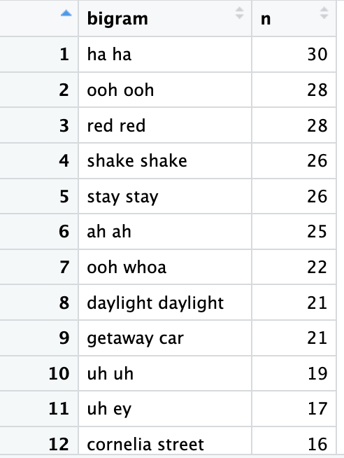
Top Bigrams
tidy_lyrics_bigram_count <- tidy_lyrics_bigram_united%>%
count(word) %>%
arrange(desc( n))
Because these are song lyrics, a lot of bigrams are the same word repeated
a lot of sounds as well (ooh ohh, ha ha)
You could try to filter out sounds as additional stop words

